Slide 1
Module 1 Artemis
Notes:
The aim of this Module is for you to become familiar with the basic functions of Artemis using a series of worked examples.

Slide 2
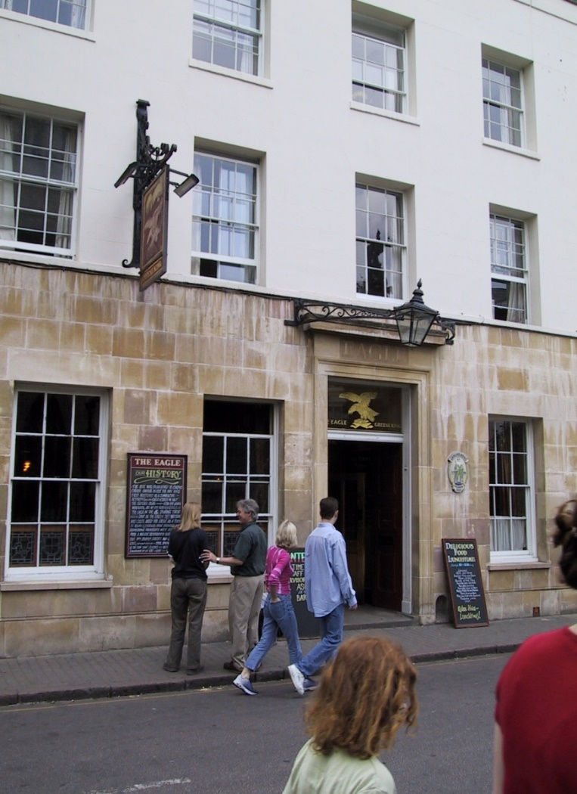
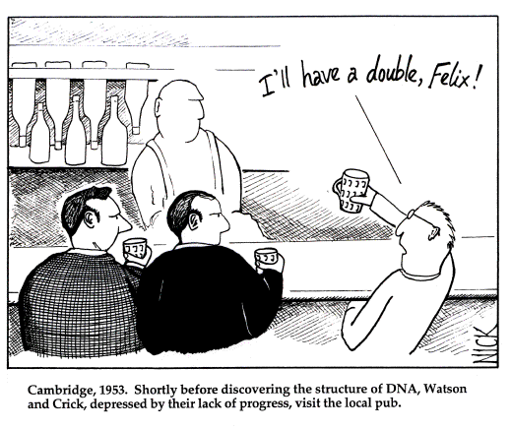
It all started at the pub…

Slide 3
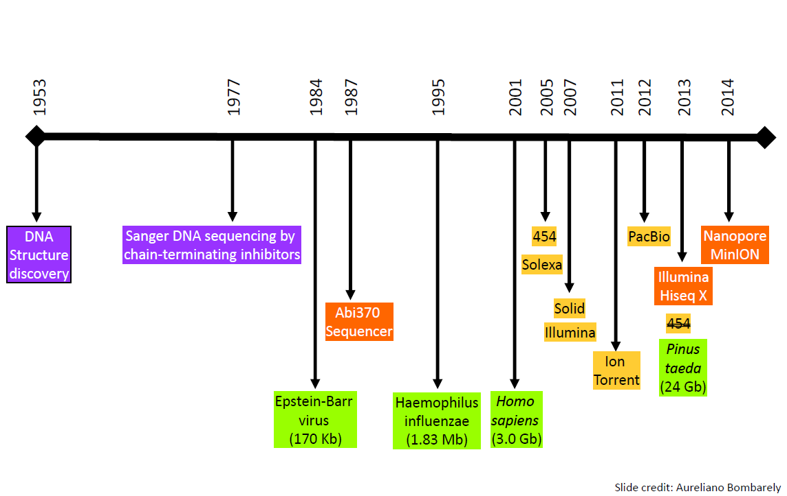
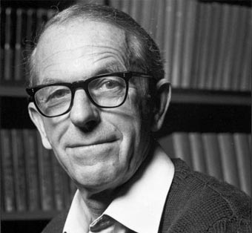
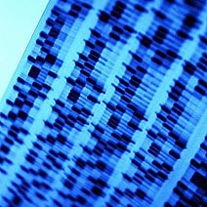
Brief history of sequencing … and bioinformatics
Atlas of protein sequences (Dayhoff)
1977 First program to collect φX174 sequence data (McCallum & Smith)
Sequence data handling by computers (Staden)
1980 EMBL Data bank
1981 1st Nucleic acid sequence database (Dayhoff)
GenBank started @ NCBI
FastA (Pearson & Lippman)
BLAST (Altschul & Pearson)
Phred (Green)
TIGR Assembler
1965
Phage FX 174
(5368 bp)
E.Coli
Ala-tRNA
(77 nt)

Slide 4
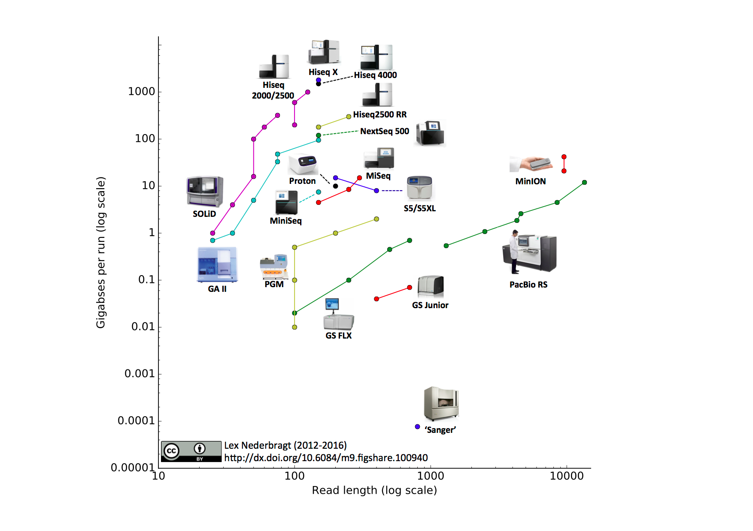
Sanger, NGS, 3rdGen

Slide 5
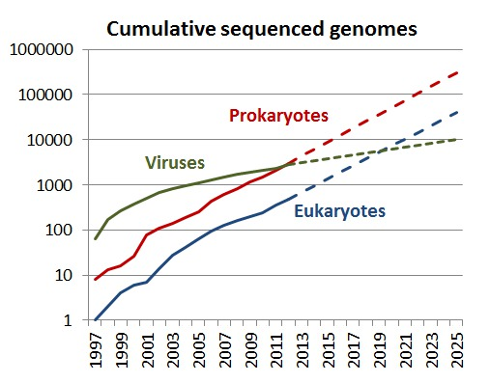
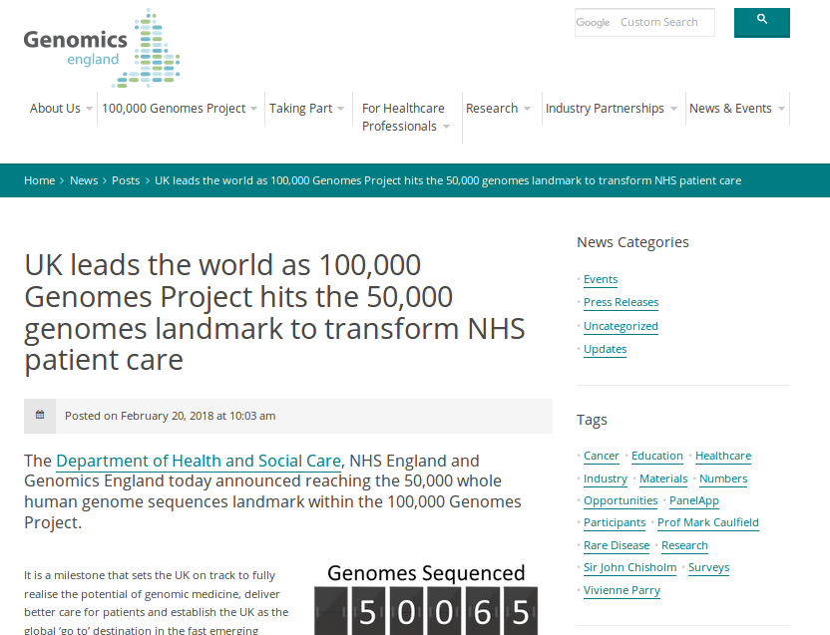
Su, Andrew (2013): Cumulative sequenced genomes. figshare.
http://dx.doi.org/10.6084/m9.figshare.722952Retrieved 14:45, Nov 29, 2015 (GMT)

Slide 6
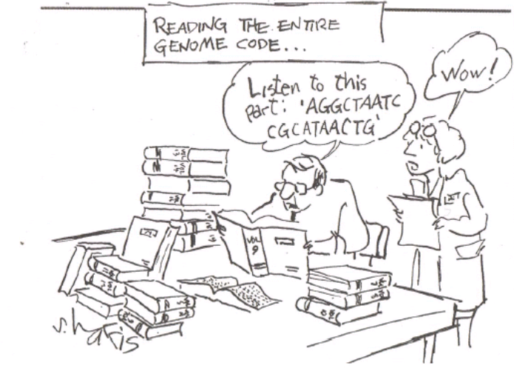
We have a sequence, now what?

Slide 7

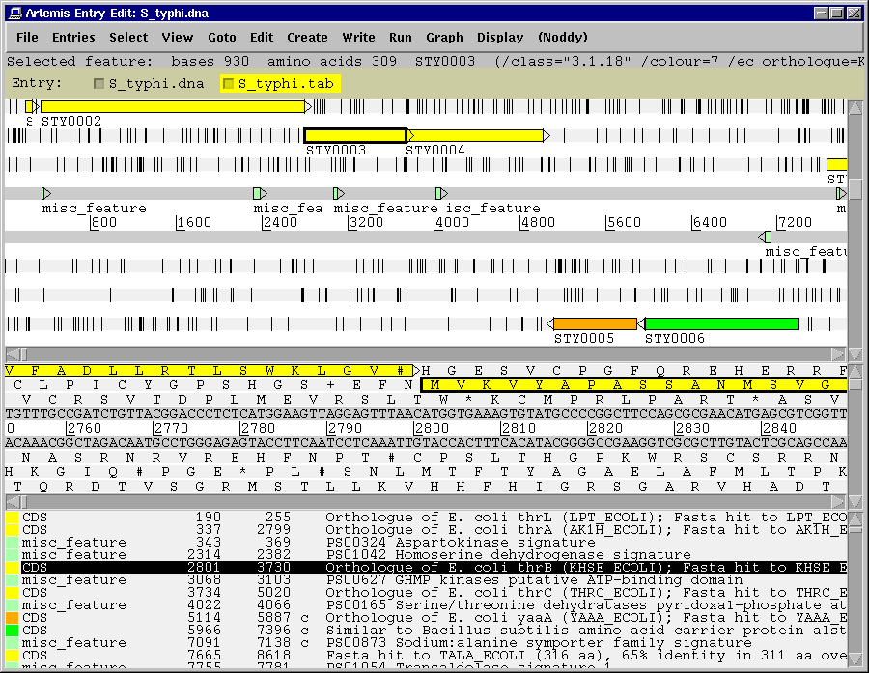
Genome browser and annotation tool
visualization of sequence
DNA
six frame translation
Panoramic and sequence view
Annotation
Features
Mapped and listed
Editable
In layers (entry)
perform and view analysis
basic analysis
Basic stats & index can be plotted
import and view the results of other searches/analysis
Different lines of evidence can be seen together

Slide 8
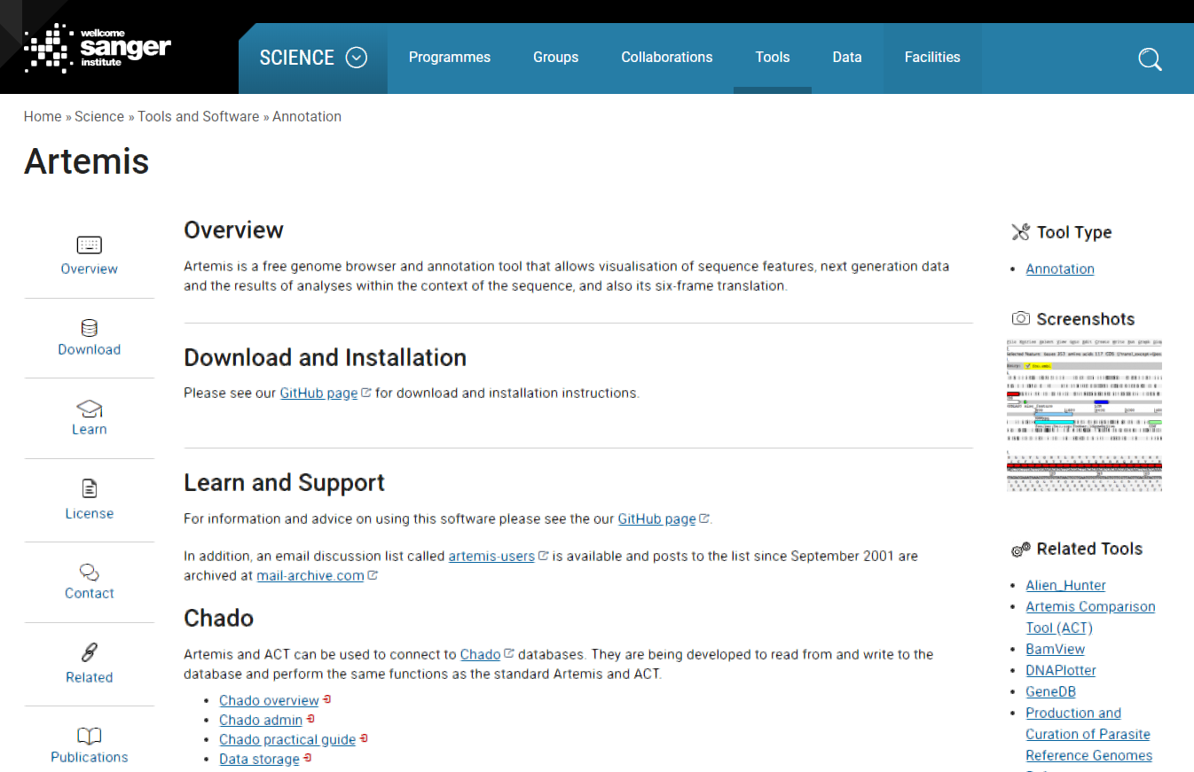
Genome browser and annotation tool (Rutherford et al, 2000)
Free and regularly updated software
(https://www.sanger.ac.uk/science/tools/artemis)
Developed in JAVA in 1998
Available for UNIX, Macintosh and Windows
Developed for annotation and analysis of prokaryotic and small eukaryotic genomes
Can be used simply as a sequence viewer allowing the visualization of sequence and annotation taken directly from EMBL or GeneBank.

Slide 9
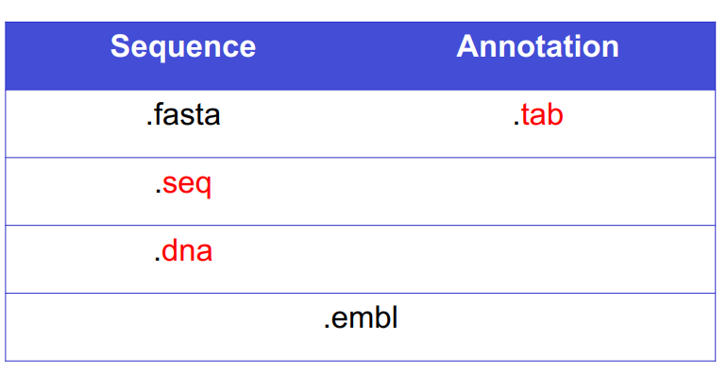
Files in Artemis
It can read several file formats (FASTA, EMBL, GENEBANK, GFF).
Notes:
Artemis can read several file formats, thus files containing sequence data with accompanying annotation or sequence data alone can be opened. In both cases, annotation can be added to the file or further annotation can be layered onto the sequence from separate files. Each layer of annotation is called an entry and in most cases consist simply of a table or tab file (a file consisting of only the feature table lines (those marked FT) from an EMBL entry. The use of entries is central to using Artemis effectively; it allows different types of annotation representing different lines of evidence to be viewed independently.

Slide 10
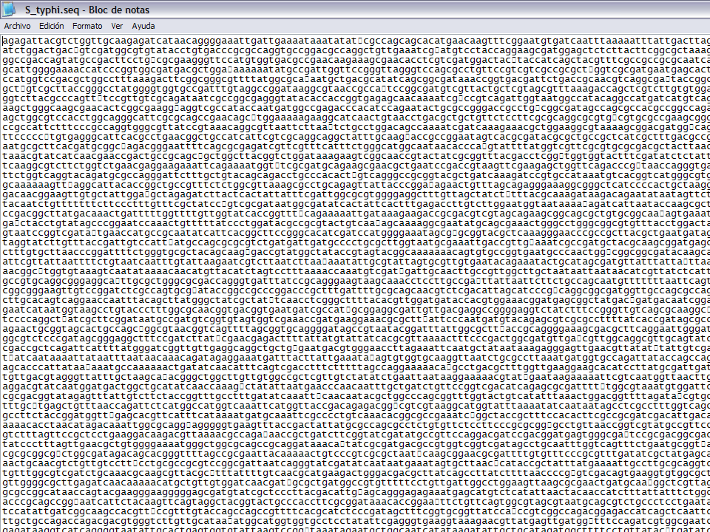
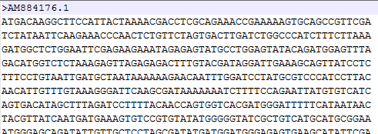
Fasta file
header line
Sequence line

Slide 11
Two-character line code indicates the type of information contained in the line
EMBL
Genbank
ID ECRSMA standard; DNA; PRO; 500 BP.
XX
AC L40173;
XX
SV L40173.1
XX
DT 10-AUG-1995 (Rel. 44, Created)
DT 04-MAR-2000 (Rel. 63, Last updated, Version 4)
XX
DE Erwinia carotovora repressor (rsmA) gene, complete cds.
XX
KW repressor; rsmA gene.
XX
OS Pectobacterium carotovorum
OC Bacteria; Proteobacteria; Gammaproteobacteria; Enterobacteriaceae;
OC Pectobacterium.
XX
RN [1]
RP 1-500
RA Cui Y., Chatterjee A., Liu Y., Dumenyo C.K., Chatterjee A.K.;
RT "Identification of a global repressor gene, rsmA, of Erwinia carotovora
RT subsp. carotovora that controls extracellular enzymes,
RT N-(3-oxohexanoyl)-L-homoserine lactone, and pathogenicity in soft-rotting
RT Erwinia spp";
RL J. Bacteriol. 177(17):0-0(1995).
XX
DR GOA; Q47620; Q47620.
DR SWISS-PROT; Q47620; CSRA_ERWCA.
XX
FH Key Location/Qualifiers
FH
FT source 1..500
FT /db_xref="taxon:554"
FT /organism="Pectobacterium carotovorum"
FT /strain="71"
FT /sub_species="carotovora"
FT -10_signal 107..112
FT /gene="rsmA"
FT RBS 235..239
FT /gene="rsmA"
FT CDS 246..431
FT /codon_start=1
FT /db_xref="GOA:Q47620"
FT /db_xref="SWISS-PROT:Q47620"
FT /note="putative"
FT /transl_table=11
FT /gene="rsmA"
FT /function="global repressor"
FT /protein_id="AAA74502.1"
FT /translation="MLILTRRVGETLIIGDEVTVTVLGVKGNQVRIGVNAPKEVSVHRE
FT EIYQRIQAEKSQPTSY"
XX
SQ Sequence 500 BP; 140 A; 101 C; 120 G; 139 T; 0 other;
ggatccggca agcaggatag aaagtgtgtt accttcagat attctgaagc tttacatgct 60
cagttctgtt gttgtgataa caaaagcaca agctactgat atcgactaaa ctaacaagta 120
gtgacaaacc ggagtgtgat ggtgtggtta taccatcgtc taggtttacg ttttcacagc 180
acatgatgga taatggcggg gagacagaga gacccgactc tttataatct ttcaaggagc 240
aaagaatgct tattttgact cgtcgagttg gcgaaaccct catcatcggc gatgaggtaa 300
cggttaccgt attaggagtg aaaggcaacc aggtgcgtat tggtgttaat gcacctaaag 360
aggtttctgt ccaccgtgaa gagatctatc agcgtattca ggccgaaaaa tctcaaccaa 420
cgtcatattg attgacaatg cgtctcgtgt tcgcgggacg caattgttat ttccggtttt 480
tcccccacac atttatcgat 500
//
Header
LOCUS ERWRSMA 500 bp DNA linear BCT 19-AUG-1995
DEFINITION Erwinia carotovora repressor (rsmA) gene, complete cds.
ACCESSION L40173
VERSION L40173.1 GI:927031
KEYWORDS repressor; rsmA gene.
SOURCE Pectobacterium carotovorum
ORGANISM Pectobacterium carotovorum
Bacteria; Proteobacteria; Gammaproteobacteria; Enterobacteriaceae;
Pectobacterium.
REFERENCE 1 (bases 1 to 500)
AUTHORS Cui,Y., Chatterjee,A., Liu,Y., Dumenyo,C.K. and Chatterjee,A.K.
TITLE Identification of a global repressor gene, rsmA, of Erwinia
carotovora subsp. carotovora that controls extracellular enzymes,
N-(3-oxohexanoyl)-L-homoserine lactone, and pathogenicity in
soft-rotting Erwinia spp
JOURNAL J. Bacteriol. 177(17) (1995) In press
COMMENT Original source text: Erwinia carotovora (strain 71, sub_species
carotovora) DNA.
FEATURES Location/Qualifiers
source 1..500
/organism="Pectobacterium carotovorum"
/strain="71"
/sub_species="carotovora"
/db_xref="taxon:554"
gene 107..431
/gene="rsmA"
-10_signal 107..112
/gene="rsmA"
RBS 235..239
/gene="rsmA"
CDS 246..431
/gene="rsmA"
/function="global repressor"
/note="putative"
/codon_start=1
/transl_table=11
/protein_id="AAA74502.1"
/db_xref="GI:927032"
/translation="MLILTRRVGETLIIGDEVTVTVLGVKGNQVRIGVNAPKEVSVHR
EEIYQRIQAEKSQPTSY"
BASE COUNT 140 a 101 c 120 g 139 t
ORIGIN
1 ggatccggca agcaggatag aaagtgtgtt accttcagat attctgaagc tttacatgct
61 cagttctgtt gttgtgataa caaaagcaca agctactgat atcgactaaa ctaacaagta
121 gtgacaaacc ggagtgtgat ggtgtggtta taccatcgtc taggtttacg ttttcacagc
181 acatgatgga taatggcggg gagacagaga gacccgactc tttataatct ttcaaggagc
241 aaagaatgct tattttgact cgtcgagttg gcgaaaccct catcatcggc gatgaggtaa
301 cggttaccgt attaggagtg aaaggcaacc aggtgcgtat tggtgttaat gcacctaaag
361 aggtttctgt ccaccgtgaa gagatctatc agcgtattca ggccgaaaaa tctcaaccaa
421 cgtcatattg attgacaatg cgtctcgtgt tcgcgggacg caattgttat ttccggtttt
481 tcccccacac atttatcgat
//
Feature Key
Qualifier
Annotation
Sequence
Notes:
Artemis is a piece of software which has been written to allow user-friendly viewing, annotation and analysis of DNA. As we were told earlier (and probably subsequently by lots of speakers), the recent major advances in sequencing technology has meant that the public DNA databases are rapidly expanding. This obviously represents an enormous resource of biological data. Unfortunately the data needs to be in a machine readable format such as this (EMBL entry flys in). This is an entry from the EMBL DNA database for the lac operon from E. coli – it give all the information – DNA sequence and coordinates within that sequence of the coding open reading frames, promoters etc but it is clearly not easy to visualise. Read this file into Artemis and you get this (Artemis window flies in). Here you have a much clearer view of the relative position of all the features on this piece of DNA and this is what makes Artemis such a crucially important piece of software (briefly describe the layout of the main view window). Now for the lac operon it may not be too painful to draw the detail on paper or in Powerpoint, however with a whole genome (and there are a growing number out there) it would clearly be impractical. Fortunately Artemis has no limits in this respect and can quite easily deal with whole bacterial genomes (Sco chromosome EMBL flies in). This is the front page of the EMBL entry for the 8 Mb Streptomyces coelicolor chromosome, if you wanted to read it you would have to trawl though nearly 4500 pages. Here it is loaded into Artemis and zoomed out to give a whole genome view (whole Sco Artemis flies in).
A very important feature of this software is the fact that its free! Not only is it free but the downloading and installation is encouraged by us and facilitated by clear jargon-free web pages.
The programming language which Artemis was written in is Java so you would need to have Java installed on your computer. Many modern computers will already have this but if not the installation of Java is also clearly described in the Artemis web pages.
Different versions of the software are available from the web page so installation on different kinds of machines eg. PC, Mac and Unix (and its cousins Linux and BSD). I should point out that historically big computers were more likely to use the Unix operating system so Unix became the platform of choice for bioinformatics. For this reason Artemis was initially written for Unix but the realisation that the user base was going to extend outside the field of bioinformatics prompted us to make the other versions available.
As I showed you before you can read EMBL format files, of any size, into Artemis. There are 3 major public sequence databases in the world – EMBL in Europe, Genbank in the US and DDBJ in Japan. They swap data on a daily basis so represent the same data. Unfortunately EMBL has a different file format from the other two (files fly in). Fortunately for us Artemis can read both formats so it doesn’t matter where you download the file from. Incidentally if you create any annotation using Artemis it will allow you to save it in either of these formats.
As well as reading database entries, you can read in your own sequence data in FastA or raw format – warning, don’t try reading in Word documents!

Slide 12

Artemis
Drop Down Menus
Drop Down Menus
Entry Button Line
Entry Button Line
Main Sequence View Panel
Main Sequence View Panel
Sliders
Magnified Sequence View Panel
Magnified Sequence View Panel
Sliders
Feature Menu
Feature Menu

Slide 13
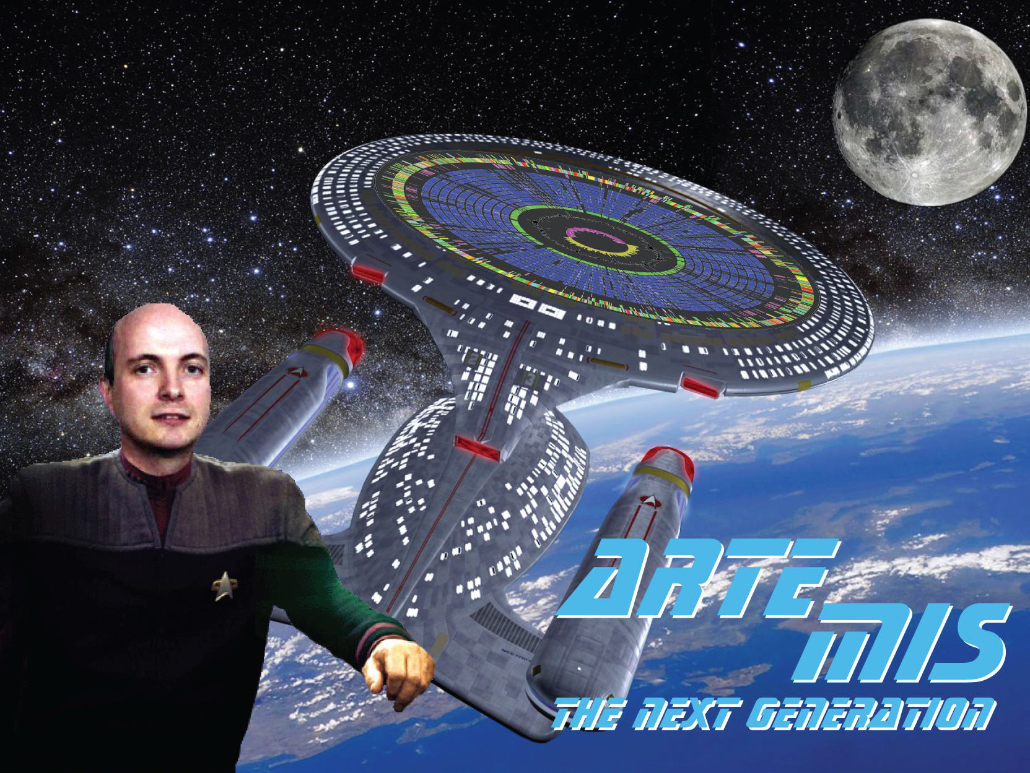
artwork by Simon Harris
Notes:
As we were told earlier (and probably subsequently by lots of speakers), the recent major advances in sequencing technology has meant that the public DNA databases are rapidly expanding. This obviously represents an enormous resource of biological data. Unfortunately the data needs to be in a machine readable format such as this (EMBL entry flys in). This is an entry from the EMBL DNA database for the lac operon from E. coli – it give all the information – DNA sequence and coordinates within that sequence of the coding open reading frames, promoters etc but it is clearly not easy to visualise. Read this file into Artemis and you get this (Artemis window flies in). Here you have a much clearer view of the relative position of all the features on this piece of DNA and this is what makes Artemis such a crucially important piece of software (briefly describe the layout of the main view window). Now for the lac operon it may not be too painful to draw the detail on paper or in Powerpoint, however with a whole genome (and there are a growing number out there) it would clearly be impractical. Fortunately Artemis has no limits in this respect and can quite easily deal with whole bacterial genomes (Sco chromosome EMBL flies in). This is the front page of the EMBL entry for the 8 Mb Streptomyces coelicolor chromosome, if you wanted to read it you would have to trawl though nearly 4500 pages. Here it is loaded into Artemis and zoomed out to give a whole genome view (whole Sco Artemis flies in).
A very important feature of this software is the fact that its free! Not only is it free but the downloading and installation is encouraged by us and facilitated by clear jargon-free web pages.
The programming language which Artemis was written in is Java so you would need to have Java installed on your computer. Many modern computers will already have this but if not the installation of Java is also clearly described in the Artemis web pages.
Different versions of the software are available from the web page so installation on different kinds of machines eg. PC, Mac and Unix (and its cousins Linux and BSD). I should point out that historically big computers were more likely to use the Unix operating system so Unix became the platform of choice for bioinformatics. For this reason Artemis was initially written for Unix but the realisation that the user base was going to extend outside the field of bioinformatics prompted us to make the other versions available.
As I showed you before you can read EMBL format files, of any size, into Artemis. There are 3 major public sequence databases in the world – EMBL in Europe, Genbank in the US and DDBJ in Japan. They swap data on a daily basis so represent the same data. Unfortunately EMBL has a different file format from the other two (files fly in). Fortunately for us Artemis can read both formats so it doesn’t matter where you download the file from. Incidentally if you create any annotation using Artemis it will allow you to save it in either of these formats.
As well as reading database entries, you can read in your own sequence data in FastA or raw format – warning, don’t try reading in Word documents!

Slide 14
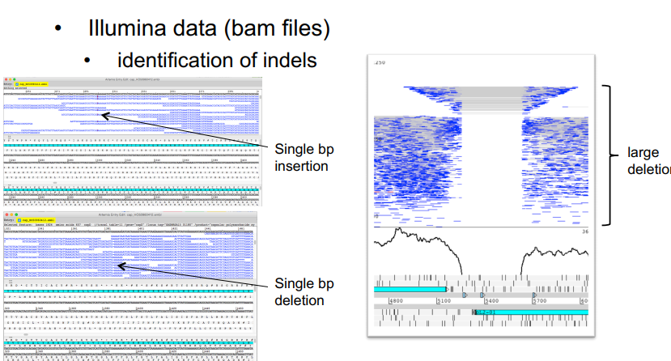
Artemis, the next generation
we will see it on Module 4

Slide 15
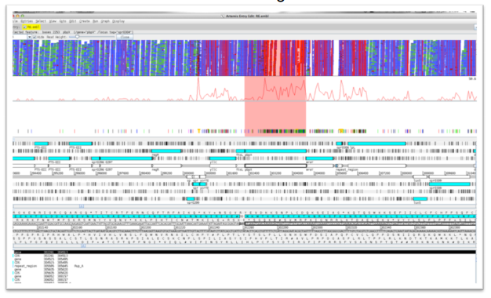
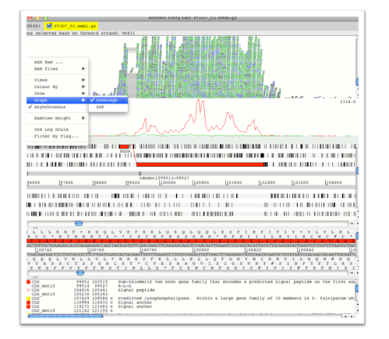
Artemis, the next generation
auto-generation of SNP density and coverage plots
RNAseq mapping
Illumina data (bam files)

Slide 16
Features of the Artemis module
Exercise 1 Familiarize with Artemis
Loading sequences and annotation files
changing the view
Searching and getting around
Exercise 2
Graphs and plots
Exercise 3
Basic analysis
Generating features
Exercise 4 Feature editing
Adding and Modifying annotations
Finding evidence : Database searches
Notes:
16

Slide 17


